Slide 1


Slide 2


Intelligent Intrusion Detection System(IIDS)
PMAS-Arid Agriculture University- Rawalpindi University Institute of Information Technology
Mohib Younis 18-ARID-2638
Adil Riaz 18-ARID-2597
Talal Ahmad 18-ARID-2715
Supervisor : Mr. Zeeshan Javed

Slide 3

Contents
Introduction
Existing System
Problem Statement
Problem Solution
Project Scope
Project Objective
Diagrams - Use case, Class, Sequance,, Component, Activity, Deployment
Tools and Technologies
Task Distribution
Screenshots
Future Project Schedule
University Institute of Information Technology, PMAS-Arid Agriculture University- Rawalpindi

Slide 4
Introduction
IIDS system handle various sensitive user data that are prone by various attack from both internal and external intruders.
Network Based Intrusion Detecting System(NIDS) detects malicious traffic on Network.
A Host-based Intrusion Detecting System(NIDS) monitors the computer insfastructure on which it is installed.
University Institute of Information Technology, PMAS-Arid Agriculture University- Rawalpindi

Slide 5
Existing System
There exists some existing system related to our project are as follows:
IoTBot-IDS: This system used statistical approach to detect botnet and DDoS attacks and lacks the realtime detection of malwares.
Intrusion detection aware componenet-based system: Component based Software engineering (CBSE) increases the reusability of software and hence decreases software development time and cost
University Institute of Information Technology, PMAS-Arid Agriculture University- Rawalpindi

Slide 6
Problem Statement
Existing security mecahnisms protect computers and networks from unauthorized use through passwords.
If these access controls are compromised or bypassed an intruder may gain unauthorized access and can cause great damage to user’s data.
A system cannot rely on access control mechanisms to safegaurd from penetration or insider attack.
University Institute of Information Technology, PMAS-Arid Agriculture University- Rawalpindi

Slide 7
Proposed Solution
By combaning both (Network Intrusion Detection System ) NIDS and (Host Intrusion Detection System ) HIDS collaboratively an effect deep learning approach is propsed by modeling a deep-neural Network (DNN) to detect cyberattack proactively.
CTU-13 and CTU-IoT datasets in indentifing whether network traffic behaviour is normal or abnormal.
Behaviour and audit trails are used to detect abusive user activity and distinguish authorized user behaviour.
University Institute of Information Technology, PMAS-Arid Agriculture University- Rawalpindi

Slide 8
Project Scope
Scope of the Project is three-fold
IIDS can analyse encrypted data and communications activity .
IIDS will collect network flow and packets to analyse behaviour of user.
The demand of Network is increasing day-to-day to detect the unknown attacks and botnets through realtime monitoring through user’s behaviour.
University Institute of Information Technology, PMAS-Arid Agriculture University- Rawalpindi

Slide 9
Project Objectives
To monior the traffic flow for any malicious activity of a network in real-time.
To prevent abuse or overload from bandwidth and Denail of Service (DoS) attack.
To develop an Intrusion Detection System for Window-based operating System.
Provide an easy to use interface for users.
University Institute of Information Technology, PMAS-Arid Agriculture University- Rawalpindi

Slide 10
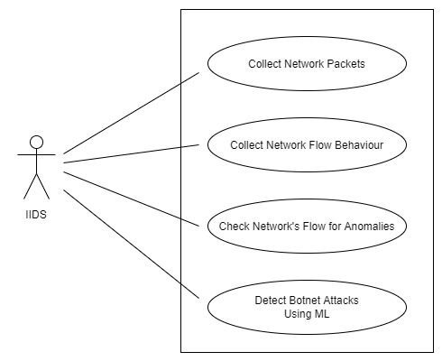
Diagrams -Use Case Diagram
University Institute of Information Technology, PMAS-Arid Agriculture University- Rawalpindi

Slide 11
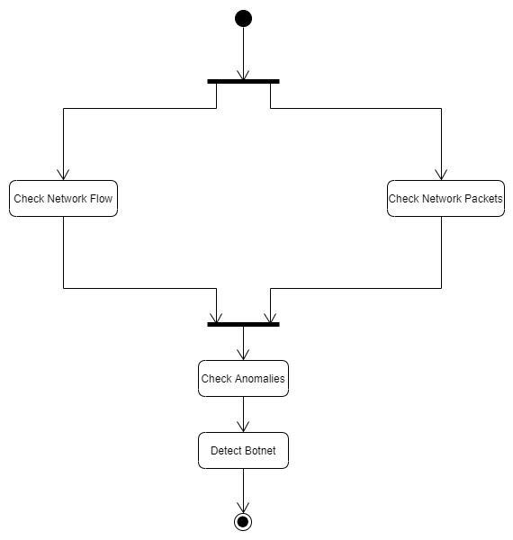
Activity Diagram
University Institute of Information Technology, PMAS-Arid Agriculture University- Rawalpindi

Slide 12
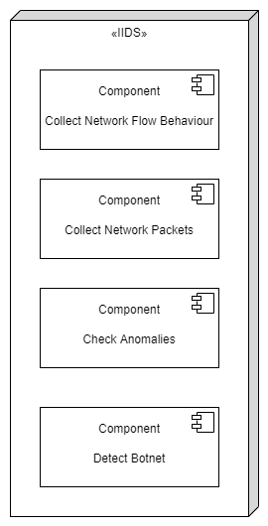
Deployment- Diagram
University Institute of Information Technology, PMAS-Arid Agriculture University- Rawalpindi

Slide 13
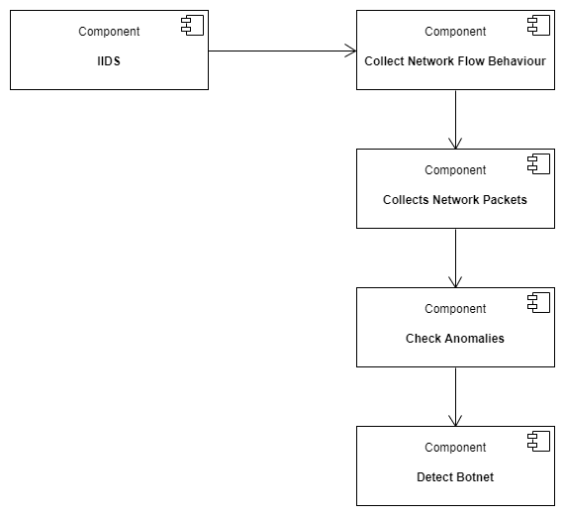
Component-Diagrams
University Institute of Information Technology, PMAS-Arid Agriculture University- Rawalpindi

Slide 14
Tasks Distribution
Group Members | Responsibilities
Talal Ahmad | Creating GUI Frontpage. Designing Interfaces- Designing and Coding for GUI. Documentation
Mohib Younis | Loading Dataset Creating Dataset.py file. Documentation
Adil Riaz | Creating Model. Training Model. Documentation
University Institute of Information Technology, PMAS-Arid Agriculture University- Rawalpindi

Slide 15





Tools & Technologies
University Institute of Information Technology, PMAS-Arid Agriculture University- Rawalpindi

Slide 16
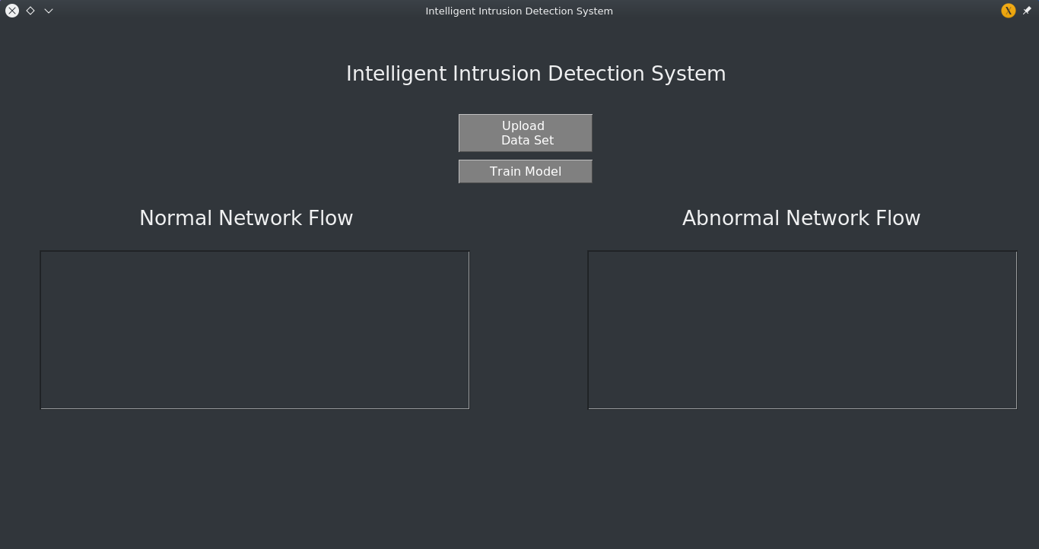
Screen Shots
University Institute of Information Technology, PMAS-Arid Agriculture University- Rawalpindi

Slide 17
Future Project Schedule
Tasks | Schedule
Design & Coding of Project Manage Feedback, Session, Gallery Pages & other Pages | 20th February To 31th March 2022
Creating Reports | 1st April to 20th April 2022
Testing of Project Module wise & Finishing the Code | 21st April To 30th April 2022
Integrating Project | 1st May 2022 To 20th May 2022
Testing of Project | 21st May To Finish Date
University Institute of Information Technology, PMAS-Arid Agriculture University- Rawalpindi

Slide 18


